Slide 1


Composed By:
Keya Mankar
12/2/2018

Slide 2

Background
Users
Current students of the Robert H Smith School of Business.
Current faculty/ staff members wanting to keep a track of alumnus.
Data
Detailed information about the alumni, their work details, their certifications,their monetary contributions to the current projects and events attended by them at the Smith School.
Source
Robert H.Smith School’s Department of Alumni Relations(DAR).

Slide 3








Technologies Used

Slide 4

Mission Statement
Connect Smith aims to provide comprehensive and high-quality information services that enables students of the Robert H. Smith School of Business to access current alumni information and get a better insight into the real world and industry dynamics.

Slide 5
Mission Objectives
To have a centralized management to maintain complete alumni information.
Track all research projects sponsored by the alumni
Track the future and past events attended by the alumni.
Provide a comprehensive repository that enlists the current and past work details of the alumni
Showcase the certifications and accolades earned by the alumnus

Slide 6
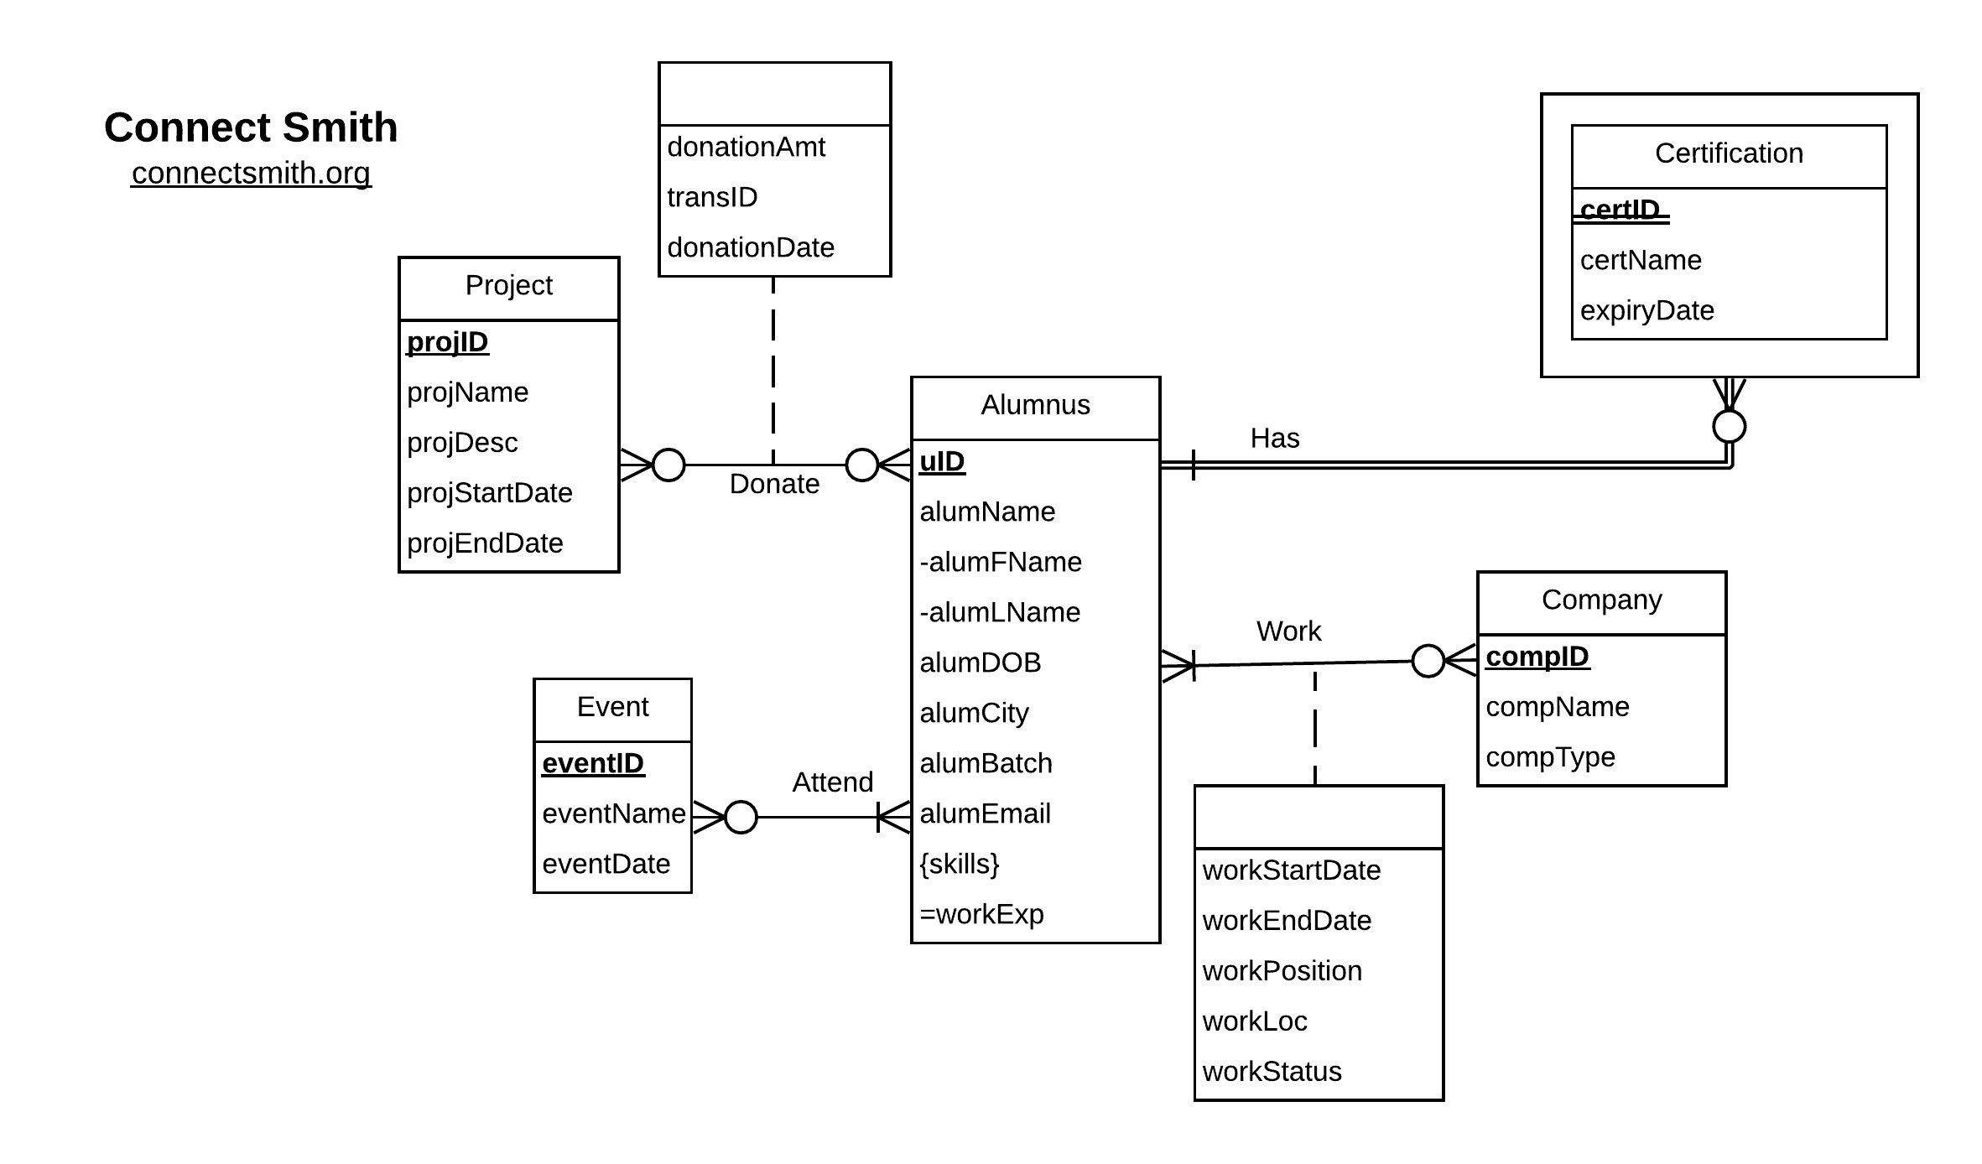
Conceptual Database Design: ER Diagram

Slide 7
Logical Database Design : Relational Schema
Alumnus (uID, alumFName, alumLName, alumDOB, alumCity, alumBatch, alumEmail)
Company (compID, compName, compType)
Event (eventID, eventName, eventDate)
Project (projID, projName, projDesc, projStartDate, projEndDate)
Certification (certID, uID, certName, expiryDate)
Work (uID, compID, workStartDate, workEndDate, workPosition, workLoc, workStatus)
Donate (uID, projID, donationAmt, transID, donationDate)
EventAttendance (uID, eventID)
AlumnusSkill (uID, skill)

Slide 8
Physical Database Design:Create Query
create table Work(
uID CHAR(8) NOT NULL,
compID CHAR(10) NOT NULL,
workStartDate DATE,
workEndDate DATE,
workPosition CHAR(50),
workLoc CHAR(20),
constraint pk_work primary key (uID,compID),
constraint fk_wuid foreign key(uID)
references Alumnus(uID)
on update cascade on delete cascade,
constraint fk_compid foreign key(compID)
references Company(compID)
on update cascade on delete no action
)

Slide 9
Business Transactions
What are the alumni details who graduated in 2014 and are working as a Jr Data Analyst in Deloitte LLP?
SELECT alumFname,alumLname,compName,alumBatch,workPosition from alumnus a
JOIN work w ON w.uID=a.uID
JOIN company c ON w.compID=c.compID
where compName ='" .$company. "' and alumBatch = $year and workPosition = '" .$position. "'
$company= Deloitte LLP $year= 2014 $position= Jr Data Analyst

Slide 10
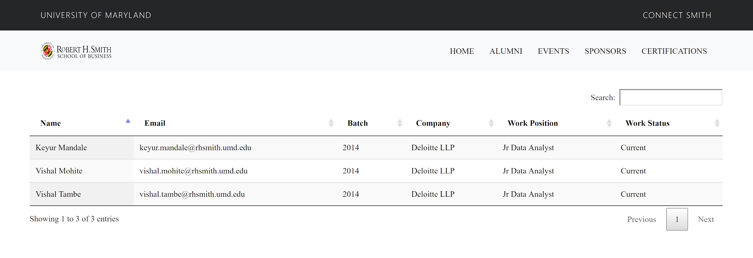
What are the alumni details who graduated in 2014 and are working as a Jr Data Analyst in Deloitte LLP?

Slide 11
Business Transactions
What are the details of the Alumni who have attended past events ?
SELECT eventName, alumFName, alumLName, alumEmail
FROM Event e
JOIN EventsAttendance ea ON e.eventID=ea.eventID
JOIN Alumnus a ON a.uID=ea.uID
WHERE eventDate < CURRENT_DATE()
ORDER BY eventName
ORDER BY alumLName

Slide 12
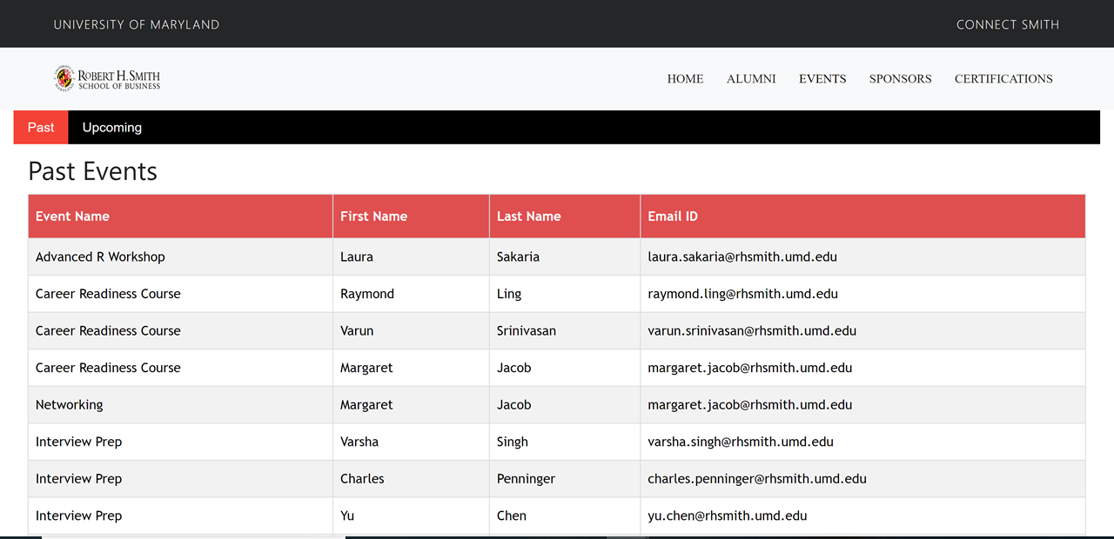
What are the details of Past Events attended by Alumni?

Slide 13
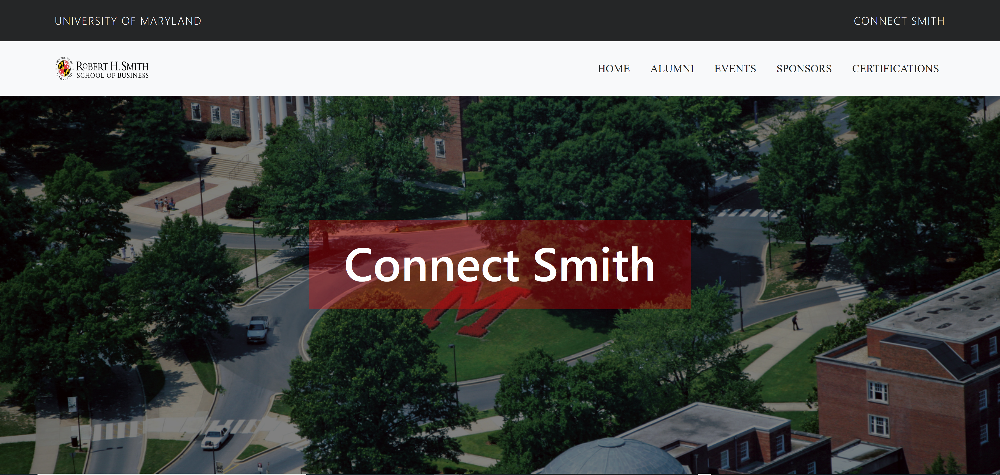

Slide 14
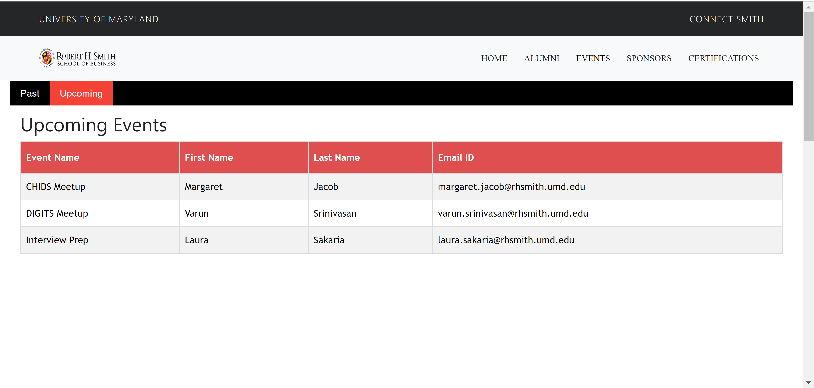
What are the First Name, Last Name, Email of the Alumni who are going to attend upcoming events?

Slide 15
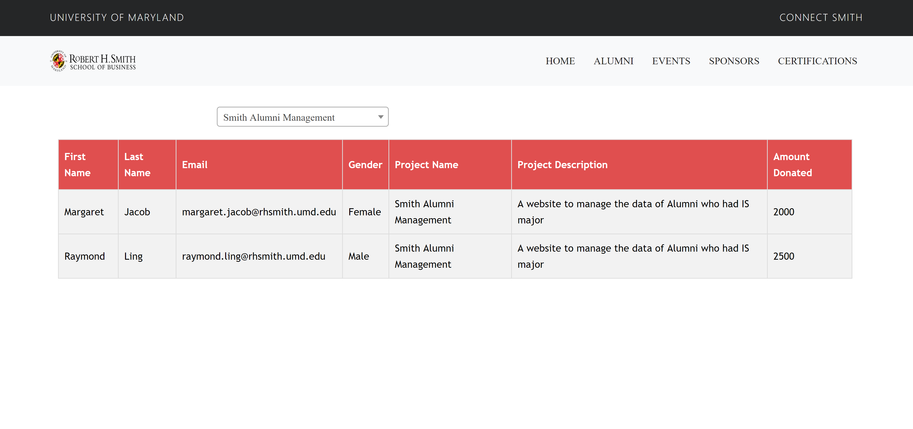
What are the First Name, Last Name, Gender, Email of Alumni who have donated for the Project ‘Smith Alumni Management’ ?

Slide 16
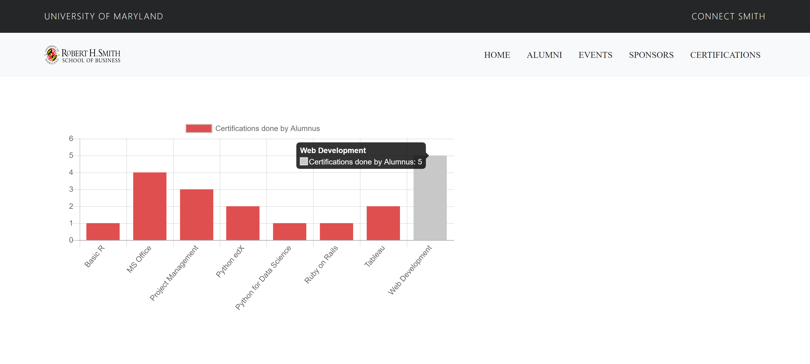
What are the Certifications and the count of each certification done by the Alumni?

Slide 17
Thank You

